Slide 1
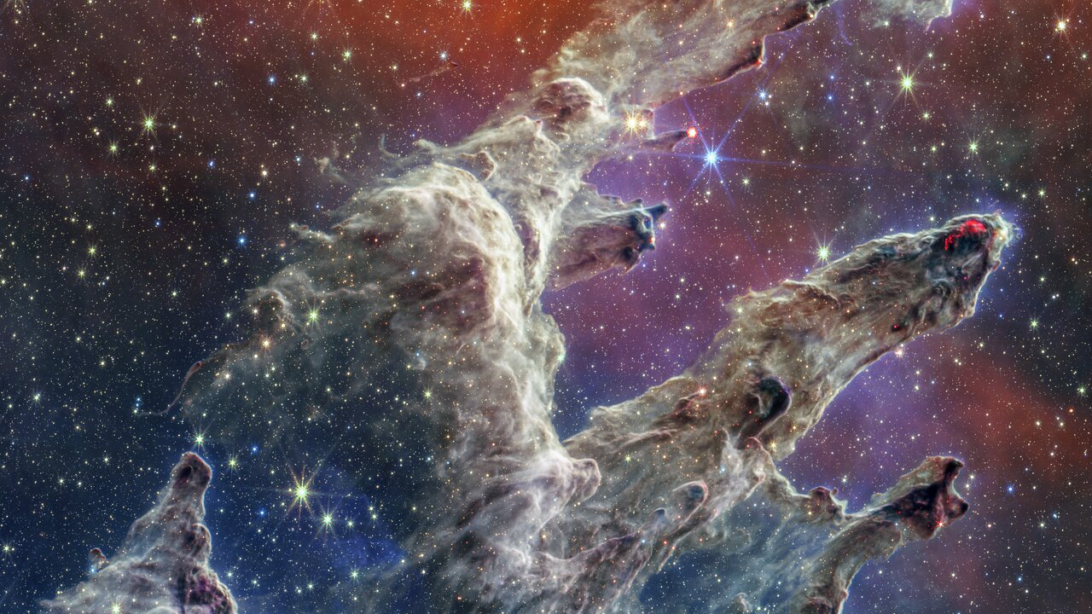
Interstellar Journey
Secrets of the
Universe
A Journey Through the Cosmos
From the Big Bang to Black Holes
13.8 Billion Years of Wonder

Slide 2
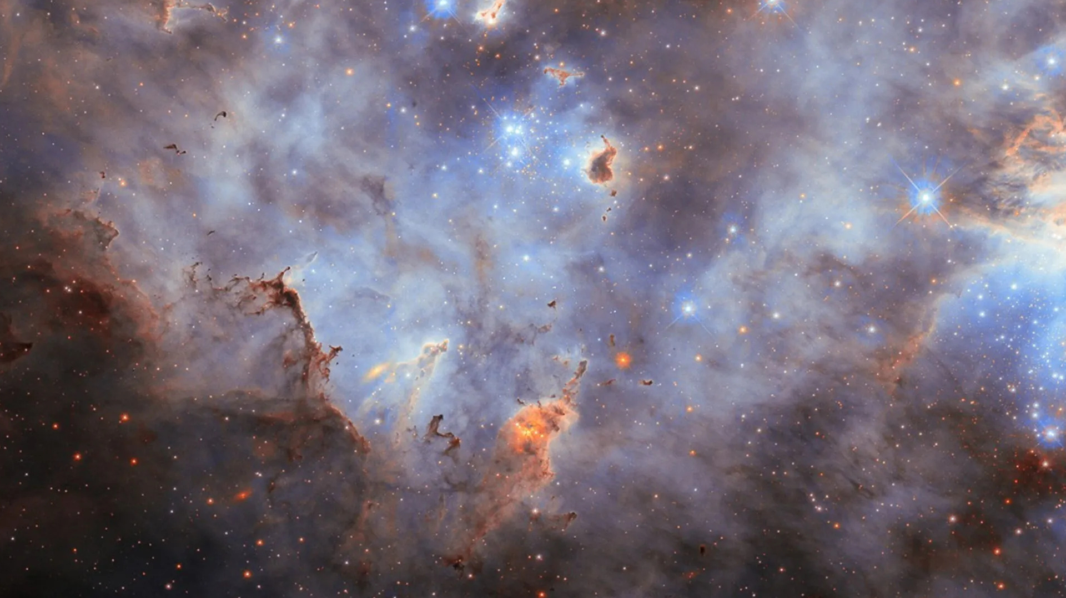
Navigation
Journey Map
01
The Cosmos Unveiled
02
Galaxies
Scale, composition, and the invisible forces shaping reality
Islands of stars spanning billions of light-years
03
The Milky Way
04
Cosmic Phenomena
Our cosmic home and its mysterious magnetic heart
Black holes, neutron stars, and gravitational waves
05
Visionaries of the Cosmos
The scientists who dared to understand the infinite

Slide 3
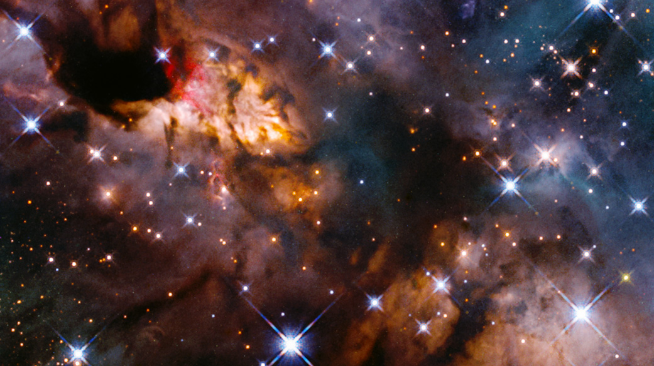
Chapter One
The Cosmos
Unveiled
Exploring the vast expanse of space and the mysteries that define our universe
Begin the journey

Slide 4
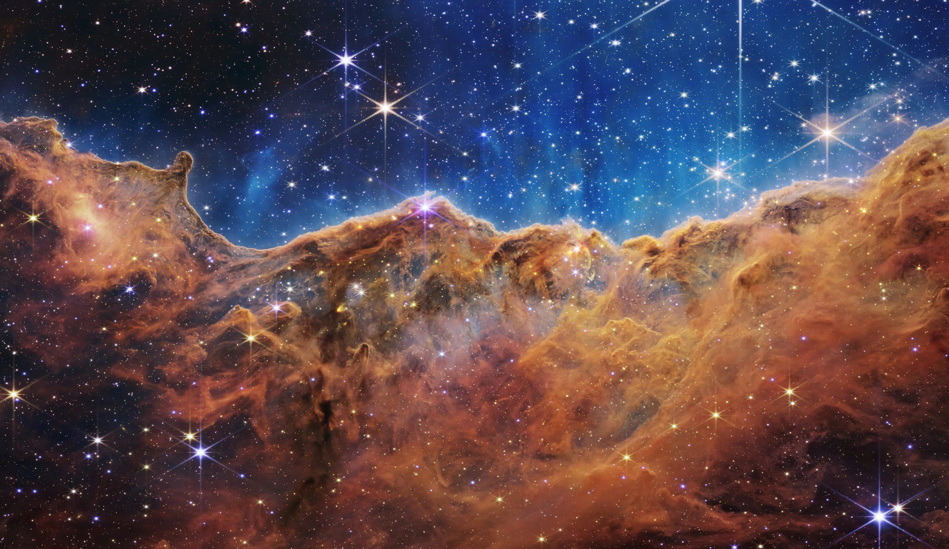
The Beginning
The Observable Universe
Mind-Bending Scale
The observable universe spans 93 billion light-years in diameter. Light from the edge has traveled for 13.8 billion years to reach us. Within this cosmic arena, scientists estimate 2 trillion galaxies exist, each containing billions to trillions of stars.
Universal Composition
Dark Energy
68%
Dark Matter
27%
The Big Bang: 13.8 Billion Years Ago
The universe began from an infinitely hot, dense point and expanded rapidly. Within the first second, fundamental forces separated and particles formed. The cosmic microwave background (CMB)—discovered in 1965 by Penzias and Wilson—provides the "baby photo" of the universe, confirming the Big Bang theory.
Visible Matter
5%
Everything we see is just 5% of reality
The Cosmic Web
Did You Know?
Galaxies are not randomly distributed—they form a vast cosmic web of filaments and nodes, separated by enormous voids. This structure emerged from quantum fluctuations in the early universe, amplified by cosmic inflation.
The CMB temperature is just 2.725° above absolute zero. Before cable TV, you could see the Big Bang's afterglow as static on unused TV channels!

Slide 5
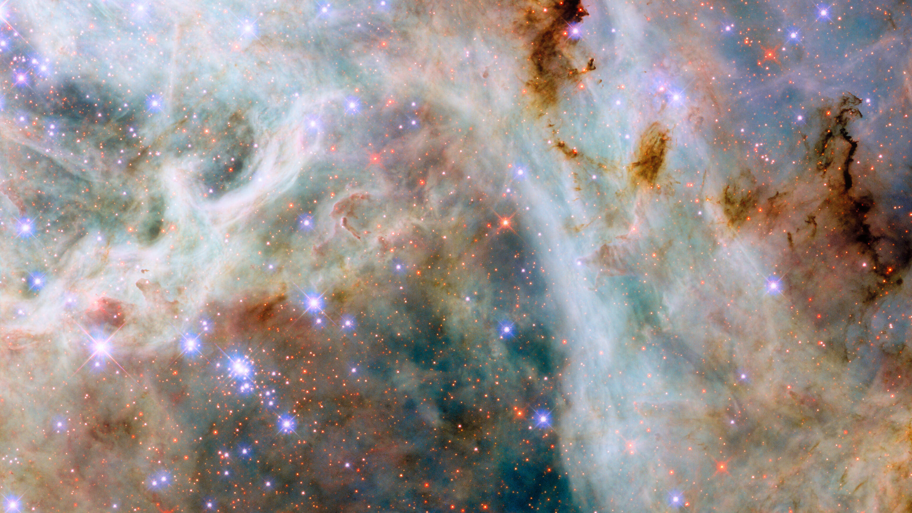
The Greatest Mysteries
Dark Matter & Dark Energy
The invisible forces that dominate our universe
Dark Matter
Dark Energy
27% of the Universe
68% of the Universe
The Invisible Scaffold
The Accelerating Expansion
Dark matter does not emit, absorb, or reflect light—it is completely invisible. Yet its gravitational pull holds galaxies together and shapes the cosmic web. Without it, galaxies would fly apart as they rotate.
In 1998, astronomers discovered the universe's expansion is accelerating, not slowing as expected. Something is pushing space outward—this is dark energy, the dominant force in the cosmos.
How We Know It Exists
Einstein's "Biggest Blunder"
In the 1970s, astronomer Vera Rubin observed that galaxies rotate faster than visible matter allows. The only explanation: invisible mass providing extra gravity. Gravitational lensing also reveals dark matter's presence.
Einstein added a "cosmological constant" to his equations to allow for a static universe, then called it his greatest mistake. Today, it may represent vacuum energy—the energy of empty space itself.
What Is It?
The Ultimate Fate
Leading candidates include WIMPs (Weakly Interacting Massive Particles) and axions. Experiments deep underground seek to detect these elusive particles.
If dark energy continues dominating, the universe faces a "Big Freeze"—endless expansion until all stars die and temperatures approach absolute zero.
The Ultimate Mystery: We can only see 5% of the universe. The other 95% remains hidden, challenging our understanding of physics itself.

Slide 6
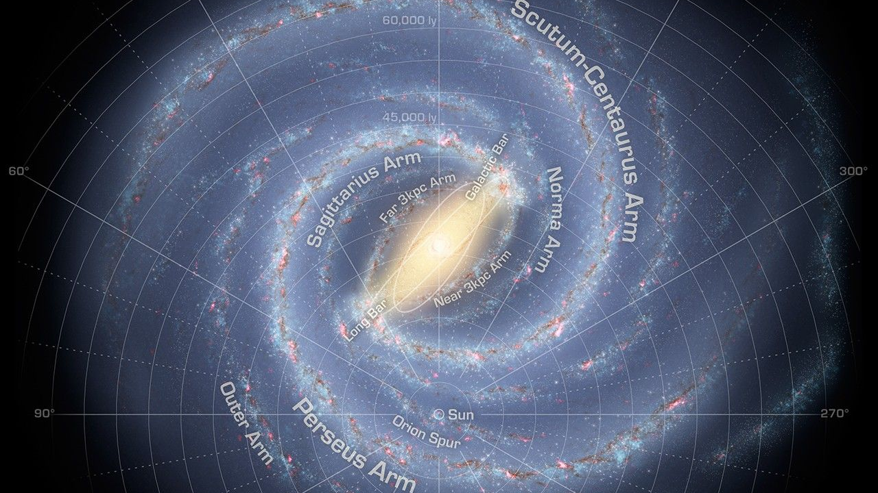
Chapter Two
Galaxies
Islands of Stars
Discovering the magnificent structures that house billions of stars across the cosmos
2 trillion galaxies await

Slide 7
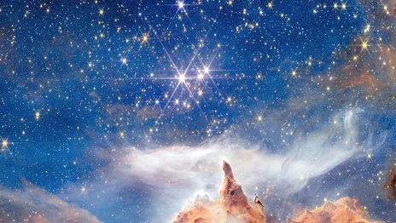
Galactic Wonders
What is a Galaxy?
Cosmic Cities of Stars
Galaxy by Numbers
A galaxy is a vast system of stars, stellar remnants, interstellar gas, dust, and dark matter bound together by gravity. These cosmic metropolises range from dwarf galaxies with a billion stars to giants hosting 100 trillion suns.
2T
Galaxies in Observable Universe
Galaxies formed within the first billion years after the Big Bang, as gravity pulled together primordial gas and dark matter. Today, they serve as the universe's building blocks, organized into clusters, superclusters, and the vast cosmic web.
100B
Average Stars per Galaxy
Galaxy Formation & Evolution
13.6B
Galaxies grow through hierarchical merging—smaller galaxies collide and combine to form larger ones. Our Milky Way has consumed dozens of smaller galaxies over its 13.6-billion-year history and continues to grow.
Years: Oldest Known Galaxy
At the center of most galaxies lies a supermassive black hole, millions to billions of times the Sun's mass. These monsters influence galaxy evolution through powerful jets and radiation.
JWST Breakthrough 2026
James Webb discovered MoM-z14, the most distant galaxy ever seen—280 million years after the Big Bang. It is brighter and more chemically enriched than predicted, challenging our understanding of early galaxy formation.

Slide 8
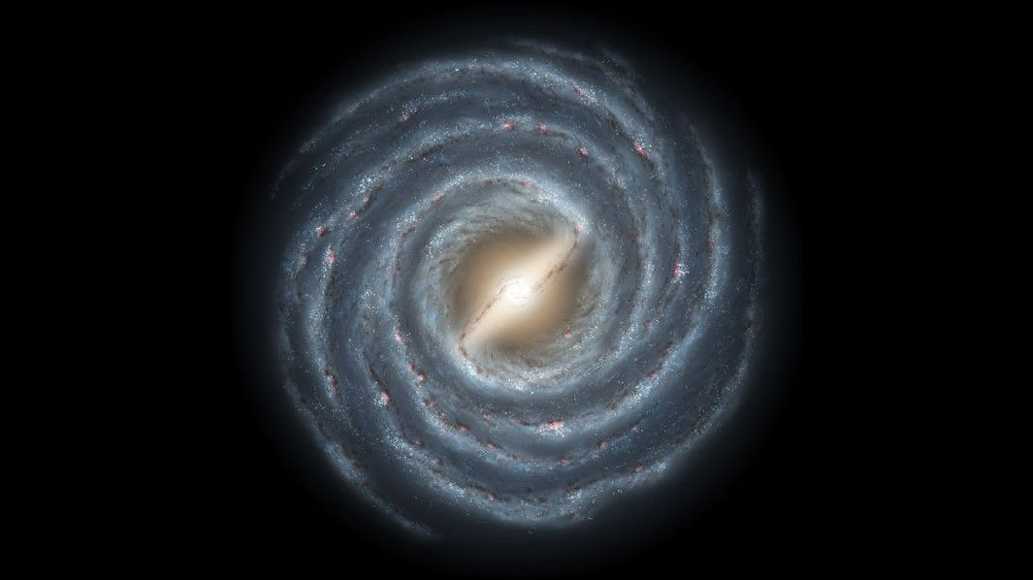
Hubble's Legacy
The Great Galaxy Classification
Edwin Hubble's system that organized the cosmic zoo
Spiral Galaxies
Elliptical Galaxies
Irregular Galaxies
Characterized by rotating spiral arms winding outward from a central bulge. These arms are density waves compressing gas and triggering star formation, creating the blue-white glow of young stars.
Football to spherical shapes ranging from nearly circular (E0) to highly elongated (E7). These are "red and dead" galaxies dominated by old, cool stars with little gas or dust for new star formation.
Chaotic, shapeless structures lacking defined spiral or elliptical forms. Often rich in gas and dust with vigorous star formation. Many result from gravitational interactions or mergers between galaxies.
Examples: M87 (home of first imaged black hole), M49, IC 1101 (largest known)
Examples: Milky Way, Andromeda (M31), Whirlpool Galaxy (M51)
Examples: Large & Small Magellanic Clouds, NGC 1427A
Features: Smooth, featureless, old stellar populations, little star formation
Features: Central bulge, spiral arms, dust lanes, active star formation
Features: No symmetry, chaotic structure, often very active star formation
The Hubble Tuning Fork: Edwin Hubble's 1926 classification scheme organized galaxies by shape, revealing an evolutionary sequence. While we now know galaxies evolve through mergers rather than simple aging, his system remains fundamental to astronomy.

Slide 9
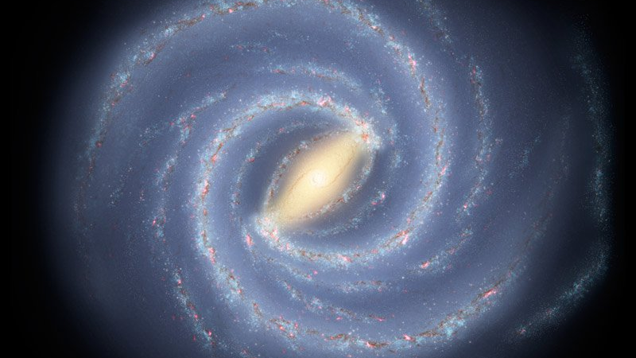
Chapter Three
The Milky Way
Our Cosmic Home
Journey through the galaxy we call home, from its spiral arms to its mysterious center
100,000 light-years across

Slide 10
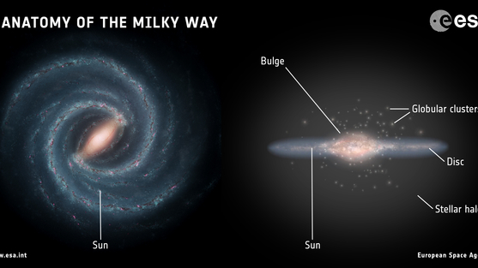
Our Galactic Address
Anatomy of the Milky Way
A barred spiral galaxy 100,000 light-years across
The Galactic Bulge & Supermassive Black Hole
Milky Way Facts
At the heart lies a central bulge 10,000 light-years across, packed with old red stars. Hidden within: Sagittarius A*, a supermassive black hole 4 million times the Sun's mass. In 2022, the Event Horizon Telescope captured its image—a glowing ring of hot gas orbiting the event horizon.
Diameter
100-120k ly
Star Count
100-400B
Spiral Arms: Cradles of Star Birth
Four major spiral arms wind outward: Perseus, Norma, Scutum-Centaurus, and Sagittarius. These density waves compress gas, triggering star formation and creating the blue glow of young stars. Our Sun sits in the smaller Orion Arm, a minor spur between Perseus and Sagittarius.
Age
13.6B years
Sun's Distance from Center
26,000 ly
The Galactic Halo & Disk
Rotation Speed
828,000 km/h
The thin disk (1,000 light-years thick) contains young stars, gas, and dust where active star formation occurs. The thick disk holds older stars. Surrounding everything is the galactic halo—a spherical region of old stars and globular clusters extending 100,000+ light-years.
Our Cosmic Address
Earth → Solar System → Orion Arm → Milky Way → Local Group → Virgo Supercluster → Laniakea Supercluster → Observable Universe

Slide 11
Breaking News 2026
The Milky Way's Magnetic Heart
First complete map of our galaxy's invisible force field
A Historic Breakthrough
The Surprising Discovery
For decades, astronomers suspected a galactic magnetic field held the Milky Way together, but its structure remained hidden. In February 2026, Dr. Jo-Anne Brown's team at the University of Calgary unveiled the first detailed map of this invisible force.
Magnetic Flip
In most of the galaxy, the magnetic field flows clockwise. But in the Sagittarius Arm, it flows counterclockwise—a reversal no one predicted.
Using the Global Magneto-Ionic Medium Survey (GMIMS) and radio telescopes at the Dominion Radio Astrophysical Observatory, they traced how magnetic fields interact with charged particles throughout the galaxy.
Diagonal Transition
The flip happens diagonally across the galaxy—a complex 3D pattern revealed by the team's new model.
Faraday Rotation: The Detection Method
The team used Faraday rotation—the bending of radio waves as they pass through magnetic fields. Lead author Rebecca Booth explains: "It's similar to how light bends when passing through a glass of water."
Why It Matters
By measuring how radio waves from distant sources twist as they travel through the galaxy, scientists mapped field strength and direction across different regions—revealing patterns never seen before.
Without this magnetic field, gravity would collapse gas and dust inward, potentially tearing the galaxy apart.
This research creates accurate models predicting how the magnetic field will evolve over time—crucial for understanding galactic evolution.
— Dr. Jo-Anne Brown, University of Calgary

Slide 12
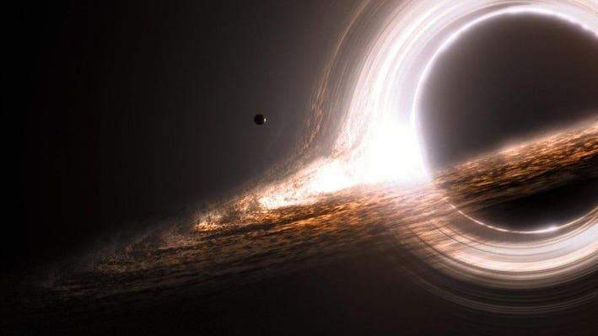
Chapter Four
Cosmic
Phenomena
Witnessing the most extreme and mysterious objects in the universe
Where physics breaks down

Slide 13
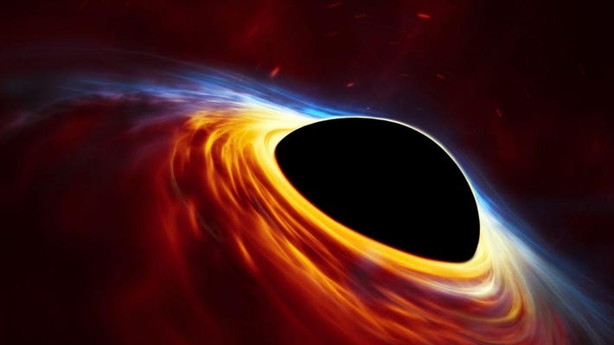
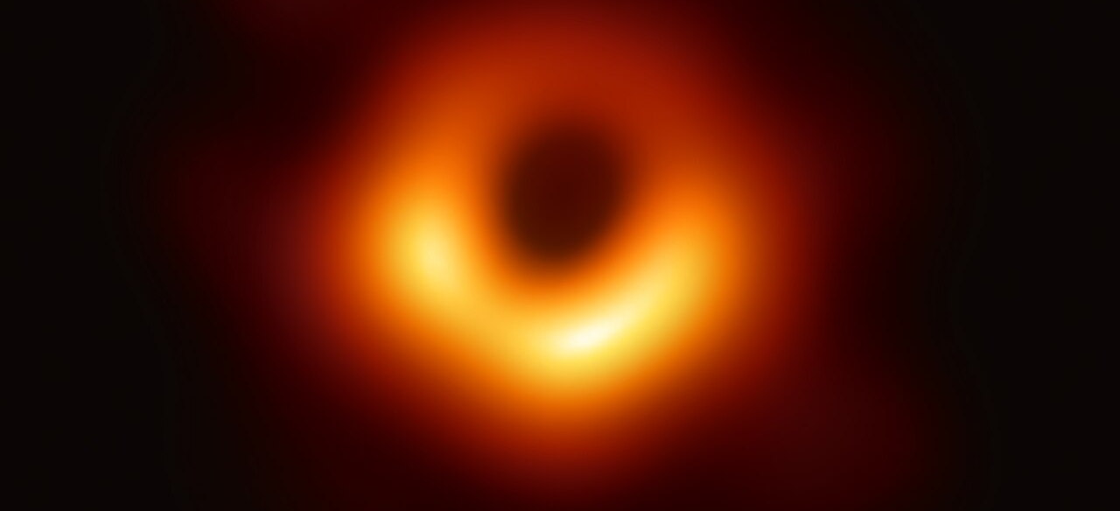
The Ultimate Mystery
Black Holes: Where Time Stops
Regions where gravity conquers all, even light itself
The Event Horizon: Point of No Return
Historic First Image
A black hole's event horizon is the boundary where escape velocity exceeds the speed of light. Cross it, and nothing—not even light—can escape. Time itself slows to a standstill at this boundary; to an outside observer, an infalling object would appear frozen forever.
At the center lies the singularity, where matter is crushed to infinite density and the laws of physics break down. Here, Einstein's general relativity meets quantum mechanics in a collision we don't yet understand.
Hawking Radiation: Black Holes Glow
April 10, 2019: Event Horizon Telescope captured the first image of a black hole—M87*—revealing a bright ring of hot gas orbiting the event horizon.
In 1974, Stephen Hawking made a shocking discovery: black holes emit radiation and slowly evaporate. Quantum effects near the event horizon create particle-antiparticle pairs; one falls in, the other escapes—stealing energy from the black hole.
Size: 40 billion km across, 6.5 billion times the Sun's mass
This Hawking radiation means black holes have temperature and entropy, connecting thermodynamics, quantum mechanics, and gravity. A stellar black hole would take 10^67 years to evaporate—far longer than the universe's current age.
LIGO Breakthroughs
Sept 2015: First gravitational wave detection
GW150914: Two black holes merged 1.3B years ago
Jan 2025: Clearest signal ever (GW250114)
Validated Einstein's general relativity

Slide 14
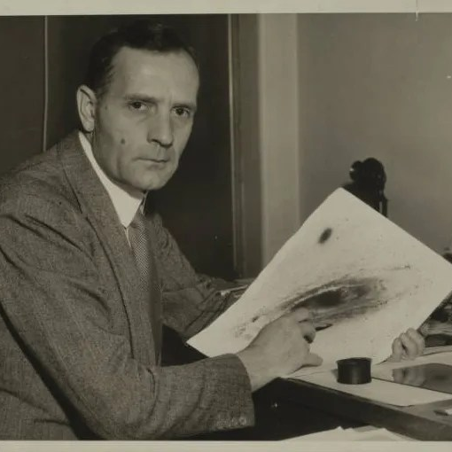

The Great Minds
Visionaries of the Cosmos
The scientists who dared to understand the infinite
Edwin Hubble
Stephen Hawking
1889 - 1953
1942 - 2018
"The man who discovered the expanding universe"
"Theoretical physicist who illuminated black holes"
Revolutionary Discoveries
Groundbreaking Contributions
1923-24: Proved galaxies exist beyond Milky Way by measuring distances to "spiral nebulae"
1974: Discovered Hawking radiation—black holes emit thermal radiation and can eventually evaporate
1929: Discovered universe is expanding—galaxies recede faster the farther away they are (Hubble's Law)
Black Hole Thermodynamics: Showed black holes have temperature and entropy
Galaxy Classification: Created the tuning fork system still used today
1988: "A Brief History of Time" sold 25+ million copies, making cosmology accessible
Hubble transformed our view from a static, single galaxy to an expanding universe of billions of galaxies. The Hubble Space Telescope bears his name, continuing his quest to see deeper into space.
Diagnosed with ALS at 21 and given 2 years to live, Hawking persevered for 55 years, becoming a symbol of scientific determination and the human spirit's triumph over adversity.
Their Legacy Continues: Today, the James Webb Space Telescope builds on their work, revealing the earliest galaxies and probing exoplanet atmospheres for signs of life—pushing the boundaries of what Hubble and Hawking could only dream of.

Slide 15
The Journey Continues
We Are Made of
Star Stuff
We have traveled from the edge of the observable universe to the heart of our galaxy, witnessed invisible forces shaping reality, and celebrated the visionaries who dared to ask the biggest questions.
The atoms in our bodies were forged in the cores of dying stars. We are the universe experiencing itself, contemplating its own existence.
The secrets of the universe are still being written.
And we are here to read them.
93 Billion Light-Years
2 Trillion Galaxies
13.8 Billion Years
The adventure has only just begun

